Slide 1
Identifying the Need for Security in Your Software Projects
Identify Security Requirements and Expectations
Identify Factors That Undermine Software Security
Find Vulnerabilities in Your Software
Gather Intelligence on Vulnerabilities and Exploits

Slide 2
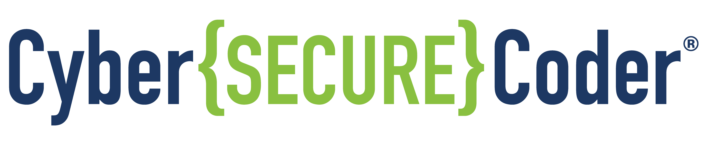
Identify Security Requirements and Expectations

Slide 3
Security Within the SDLC
Architect and design
Identify requirements
Test
Deploy and maintain
Develop
How do I identify security
requirements?
How do I design for security?
What steps can I take to harden my code against attacks?
How do I ensure no security/privacy problems are created when my software is retired or uninstalled?
How do I test security during unit and integration testing?
How do I plan, develop, and release security updates?
How do I monitor how security is affected by updates in other software and services?
How do I keep my software protected as new vulnerabilities are found?

Slide 4

Business Requirements
Are ideally defined before custom business apps are developed
Should be quite structured, well thought out, and thoroughly documented
What developers are actually provided may be minimal
The entire organization benefits if business requirements are carefully analyzed and documented
Business requirements (and software requirement specifications based on them) should clearly identify:
Special security considerations
Applicable regulations
Applicable standards
These attributes should be verified in the finished product
Small-scale development operations (as in startups or small scale app store developers)
Will follow a process very different from a large business organization
May be a company of one, or a very small team
May not have comprehensive business requirements to start with
Nonetheless have potential security risks to consider
Should take the effort to build security into the entire development process

Slide 5

Standards and Compliance Requirements
Government Regulations
Health Insurance Portability and Accountability Act (HIPAA)
Federal Information Security Management Act (FISMA)
Sarbanes-Oxley Act (SOX)
Gramm-Leach-Bliley Act (GLBA)
New York State Information Security Breach and Notification Act
Federal Financial Institutions Examination Council (FFIEC)
EU General Data Protection Regulation (GDPR)
Industry Standards
Control Objectives for Information and Related Technology (COBIT)
Information Security Management System (ISMS, a.k.a. ISO/IEC standards)
Information Technology Infrastructure Library (ITIL)
Generally Accepted System Security Principles (GASSP) and Generally Accepted Information Security Principles (GAISP)
Common Criteria for Information Technology Security Evaluation (ISO/IEC 15408)
Sherwood Applied Business Security Architecture (SABSA)
National Institute of Standards and Technology (NIST) SP800
Payment Card Industry Data Security Standard (PCI DSS)

Slide 6


User Impact
Programmers produce a wide range of software that affect users and other customers.
Users:
May or may not interact directly with your software
Can be impacted even by software they have no direct contact with
Your
Software
Impact

Slide 7
User Expectations
Users expect that your software will provide them with protection.
Privacy
Security
Confidentiality
Safety
Users must be protected from themselves, in some cases.
Users will be generous with software ratings if you protect their security and privacy.
To fulfill customer expectations, you need to:
Understand the platform your software runs on
Know where the vulnerabilities are
Develop software that protects users
Expectations
Your
Software

Slide 8
Platform Requirements
Everything is connected.
Apps that communicate with cloud services may be subject to special security rules and policies set forth by those organizations.
For example, Facebook requires that your apps:
Do not proxy, request, or collect Facebook user names or passwords
Provide a privacy policy to tell users what user data you will use and how you will use it
Include your privacy policy URL in the App Dashboard
Include a link to your app's privacy policy in the app
App stores have requirements for apps, including privacy and security
Example terms of use may be found at:
https://developer.amazon.com/help/da.html
https://legal.linkedin.com/api-terms-of-use
https://developers.facebook.com/policy/
As the app developer, it is your responsibility to read, understand, and adhere to the terms of use put forth by the service provider.

Slide 9

Consequences of Not Meeting Security Requirements
Embarrassment
Reputation loss
Job termination
Customer loss
Contract loss
Legal burdens
Reputation loss
Goodwill loss
Reduced investor confidence
Customer loss
Revenue loss
Legal indemnification
App Developer
Developer’s Organization
App Users
Other Users
Inconvenience
Frustration
Data loss
Identity theft
Loss of time
Embarrassment at having brought a faulty app into the work environment
Anger toward the developer
Inconvenience
Frustration
Time loss
Data loss
Anger toward the user who downloaded the app
Resentment toward the app developer and user

Slide 10

Identify Sources of Security Requirements
To identify sources of security-related requirements for your software, gather:
User expectations
Standards and compliance requirements
Business requirements
Requirements for platforms, services, and APIs that your software uses
Identification of where your software is vulnerable, and identify how you will address each vulnerability

Slide 11
Elicit and Prioritize Security Requirements
To ensure security requirements are comprehensive, follow a process like SQUARE:
Agree on definitions.
Identify security goals.
Develop artifacts to support security requirements definitions.
Assess risks.
Select elicitation technique(s).
Elicit security requirements.
Categorize requirements.
Prioritize requirements.
Inspect requirements.

Slide 12
Meet PCI DSS Requirements
PCI DSS is the Payment Card Industry Data Security Standard.
This standard outlines steps to implement protections for cardholder data:
Maintain secure networks
Secure cardholder data in transit and in storage
Provide malware protection on client and host systems
Restrict access to cardholder data to authorized personnel
Continually monitor for vulnerabilities
Implement and follow a comprehensive information security policy
The complete, detailed requirements may be downloaded from https://www.pcisecuritystandards.org.

Slide 13


Activity: Identifying Security Requirements and Expectations
Users can view a catalog of products, including product descriptions, pricing, and illustrations
Users can display content in various languages
Users can search for a product based on one or more keywords
New users can self-register for a customer account, which enables them to:
Purchase products online
Provide feedback to Woodworkers Wheelhouse
Log in using their application credentials or through Google using OAuth authentication
Administrators can manage user accounts

Slide 14
Identify Factors That Undermine Software Security

Slide 15

Three Ps of Software Security
Common defects harm security.
Components and platforms are not secure.
Configuration of software and host systems is not secure.
Security policies are poorly implemented.
Operator error.
Incorrect assumptions about software behavior.
Falling prey to attacks.
Unintentional unsecure behavior.
Malicious behavior.
Security is not integrated into the entire process.
Overall design is unsecure.
Software and deployments are not maintained adequately.
Development tools don’t promote security.
Product
People
Process

Slide 16
Software Security Terminology
Asset
Vulnerability
Threat
Threat Agent
Vector
Risk
Risk Ranking
Exploit
Consequence
Countermeasure

Slide 17

Activity: Identifying Factors That Undermine Security
OpenSSL
Software that protects data being transmitted over the web
Was updated New Year's Eve 2011
Code was duly reviewed and accepted, and subsequently uploaded to web servers, routers, etc.
No defects found in subsequent reviews
In use for two years until Heartbleed bug was discovered by Google and Codenomicon
500,000 lines of business-critical code
Produced as an open source project
Used widely, of critical importance to web security
The Heartbleed Bug
Caused by a missing bounds check
Enabled attackers to read memory of systems protected by OpenSSL
Exposed date including secret keys, user names and passwords, and content
Enabled attackers to eavesdrop, steal data, and impersonate services and users—leaving no trace
May have been used by intelligence agencies for espionage
Affected versions 1.0.1 through 1.0.1f of OpenSSL
Can be avoided by ignoring "Heartbeat Request" methods that ask for more data than needed
The OpenSSL development team
Consisted of mostly volunteers
Included only one individual focusing full-time on OpenSSL
Identified a primary cause of the problem as not enough double-checks of the code

Slide 18
Find Vulnerabilities in Your Software

Slide 19


Builders and Breakers
Builder (software developer)
Builds software:
Starts with a concept or a blueprint (requirements)
Gathers raw materials
Plans a strategy to produce the various parts
Uses knowledge, skills, and abilities to build a new piece of software
Breaker (cyber attacker)
Deconstructs software:
Analyzes how it’s constructed
Identifies weaknesses in its construction
Leverages weaknesses to:
Find more weaknesses
Destroy property
Spread misinformation
Gain financially
Prevent valid users from using the software

Slide 20

Hacking
Breaking software security is one aspect of an activity sometimes called hacking.
The term hacker refers to someone who engages in hacking.
Different types of hackers:
White hat—Hacks software primarily for benevolent purposes, such as security research, to find ways to improve software security.
Black hat—Hacks primarily for criminal purposes (such as extortion, theft, and cyber terrorism).
Gray hat—Doesn’t fit in the other two categories. Primarily motivated by profit, selling information they have uncovered to government agencies, for example.
Examples: Free agents, defense contractors

Slide 21
Phases of an Attack
Survey and Assess
Exploit and Penetrate
Escalate Privileges
Maintain Access
Deny Service

Slide 22

Common Attack Patterns
What can I learn about the target to help me perform subsequent attacks?
Can I gain access to privileges that I shouldn't have?
Can I pretend to be someone I'm not?
Can I read or write data to a memory location in a way that enables me to undermine security?
Can I modify the content of request parameters to undermine security?
Can I perform certain actions that will prevent legitimate users from being able to use the software?
Can I supply a file or other input data in an unorthodox form to bypass security protections?
Can I add my own malicious code or resources into the application?
Can I disguise one action for another and, therefore, trick a user into initiating one type of action when they intend to initiate a different action?
Can I misuse the functionality of the application to achieve a negative technical impact?
Can I analyze the structure, function, and composition of an object, resource, or system to determine how it was constructed or how it works?
Can I cause a user, program, server, or device to perform actions that undermine the integrity of software code, device data structures, or device firmware?

Slide 23
Common Attack Patterns—1
Reconnaissance
What can I learn about the target to help me in subsequent attacks?
Methods:
Excavation
Peek and poke at the target to "dig up" information
Includes examining and modifying URLs and query strings (in a web application), changing configuration and settings, viewing web page sources, exploring system logs and other files
Includes abuse tactics, such as entering invalid or unorthodox input values to force errors, reveal unhandled exceptions, and expose verbose error messages, stack traces, configuration data, paths, and so forth
Footprinting
Look for configuration information that might be helpful for an attack, such as open ports, software components and their versions, network topology, and similar information
Fingerprinting
Compare system output to known "fingerprints" that uniquely identify details about the system
Reconnaissance typically precedes another type of attack, so attacker will generally be careful not to perform tasks that might reveal his/her presence.

Slide 24
Common Attack Patterns—2
Reverse Engineering
Can I analyze the structure, function, and composition of an object, resource, or system to determine how it was constructed or how it works?
The goal is typically to duplicate all or part of its functionality.
Functionality Misuse
Can I misuse the functionality of the application to achieve a negative technical impact?
The system functionality is not altered or modified, but simply used in a way that was not intended. This is often accomplished through overuse of the functionality, or by leveraging defective functionality that enables misuse.

Slide 25
Common Attack Patterns—3
Gain Access Privileges
Can I gain access to privileges that I shouldn't have?
Methods:
Brute force attacks
Rapidly and repeatedly entering different secret values until finding one that unlocks access.
Secret value might be a password, encryption key, database lookup key, or some other value that should be known to a legitimate user.
Factors enabling a successful attack:
Fewer variations in the secret value (e.g., use of 8 characters instead of 16)
Use of patterns (such as real words) that can be looked up in a dictionary
Fast turnaround on failed attempts
Authentication abuse
Gain unauthorized access through a weakness in the authentication library or in its use.
Faulty software might make assumptions regarding trust relationships or in the generation of secret values that allow the attacker to gain access by performing a careful sequence of steps.
Authentication bypass
Gaining privileged access outside of the normal authentication route.
Example: After users log in, a poorly designed website normally loads a particular URL to display a page containing sensitive content. The attacker enters that URL directly into the address bar to go directly to the secure content without authenticating.

Slide 26
Common Attack Patterns—4
Memory Manipulation
Can I read or write data to a memory location in a way that enables me to undermine security?
Methods:
Buffer manipulation
Reading or writing data to a memory location in an unorthodox way that enables an attacker to read or write data outside that memory location.
Target memory locations rather than the code that reads or writes to them.
Typically, the content placed in memory during the attack doesn't matter. The typical buffer attack supplants the original content stored in the buffer, resulting in the ability to read or overwrite another memory location.
Pointer manipulation
Changing the value of pointer variables to access unintended memory locations.
This can provide access to data or functions that would not normally be accessible, or it can be used to crash the application.

Slide 27
Common Attack Patterns—5
Parameter Injection
Can I modify the content of request parameters to undermine security?
Example: Parameters in a HTTP GET message are encoded in the address as name-value pairs separated by an ampersand (&). If an attacker can supply text strings that are used to fill in these parameters, then they can inject special characters used in the encoding scheme to add or modify parameters.
Example: In many programming contexts, a null-byte character (%00 or 0x00) indicates the end of a string. By providing a null-byte character value, it may be possible to make the code ignore everything following that value, causing an error or odd behavior. For this reason, this character value is sometimes called a poison null byte.
Input Data Manipulation
Can I supply a file or other input data in an unorthodox form to bypass security protections?
Example: You may successfully bypass text input validation protections if you use a different character encoding scheme. Or you might provide a file with the wrong file extension (e.g., .png instead of .txt) to cause the software to handle the file differently.

Slide 28
Common Attack Patterns—6
Action Spoofing
Can I disguise one action for another and, therefore, trick a user into initiating one type of action when they intend to initiate a different action?
Example: The user of a web application selects a button labeled Submit, but instead of submitting a query, it downloads software to the user's computer. This might be accomplished through clickjacking, in which a user sees one interface but is actually interacting with a second, invisible, interface layered over it.
Software Integrity Attack
Can I cause a user, program, server, or device to perform actions that undermine the integrity of software code, device data structures, or device firmware?
Results in the target being put into a state that is not secure, which might be used to set the stage for a subsequent attack.

Slide 29
Common Attack Patterns—7
Infect the Application with Malicious Code
Can I add my own malicious code or resources into the application?
There are various techniques an attacker might use to add their own malicious code into a running application.
Code inclusion
Code injection
Command injection
Content spoofing
Resource location spoofing

Slide 30
Common Attack Patterns—8
Denial of Service
Can I perform certain actions that will prevent legitimate users from being able to use the software?
Denial of Service can be accomplished through a variety of approaches that directly disable services or bog down the system so much that it can't support the service anymore.
Excessive allocation
Flooding
Resource leak exposure
Sustained client engagement

Slide 31
Common Attack Patterns—9
Repudiation
Can I conduct a transaction, but make it so the system can't prove that the transaction actually took place?
Occurs when the system does not properly track and log the actions of users, or does not protect the logs.
Attacker can manipulate the system to log incorrect data, making it appear that the transaction did not take place, or that a different type of transaction occurred.
Example: Attacker might be able to make a credit card purchase while making it impossible for the system to prove that the purchase was made using a specific card number.

Slide 32
Require a Password
You decide to require new users to register a user name and password the first time they access the system.
To log in again later, users must provide the same password they provided at registration.
If users cannot provide the correct password, they will be prevented from accessing the application and its data.
At login, the application must be able to compare the password the user enters to the original password set during registration.
You might decide to keep a list of all user passwords in a database.

Slide 33

Brute Force Attack
Systematically entering passwords to try to log in to a particular account.
Having knowledge about the user (mother's name, birthday, and so forth) can help.
Tricking the user into divulging information can help.

Slide 34
Thwart Brute Force Attacks
Guessing at passwords can take a very long time.
You can put into place certain countermeasures to further thwart this kind of attack.
Purposely slow down the login or password rejection process to increase the time it takes an attacker to try out one password.
Lock the account after a number of failed login attempts.
Implement notifications and logging to warn an administrator that the application might be under attack after a certain number of failed logins.

Slide 35

Hack Password Database
Attacker might try to pull passwords directly from the database.
Passwords that you store may be used in other applications the user uses.
Users may be warned not to recycle passwords, but often do so.
It's important to protect users' passwords.

Slide 36
Protect the Database
You could encrypt passwords as you store them in the database, and decrypt them when you retrieve them.

Slide 37

Database Protections Can Be Bypassed
Unfortunately, an attacker might manage to:
Bypass the encryption in the database.
Get the application to decrypt the passwords using a side channel of some sort (such as a function you forgot to protect).
You should protect the database, but your defenses would be even better if the database didn't contain passwords at all.

Slide 38
So Don't Store Passwords at All
Hashing enables you to not store passwords, but still be able to verify passwords.
A hash is created through a one-way encryption algorithm—can’t be decrypted.
Same algorithm + same password = same hash value.
A different password will produce a different hash value—even if only one letter changes.
Password: 0pen!Sesame
Password Hash: 65ecd19dc10aa76e955f614ccf6ed156fcc772b8d1a51c4ad24b8483593a2798
Password: 0pen?Sesame
Password Hash: acc0c06cf89bc8d1290ca392898ee4ab053254a4bfb80874d007ec602ac9e1da
When the user sets a password, you can store the hash instead of the password.
At subsequent logins, you can:
Create a hash from the password the user enters.
Compare the new hash to the original hash.
If the two hashes match, then you can verify that the same password was used to create them.
This means you don’t have to store the password itself.

Slide 39

Cracking a Hash Through a Lookup Table
Suppose an attacker is able to access the database and obtain the password hashes and user names.
You might think that hashed passwords are safe because the hashes can't be decrypted.
If attacker knows the character set, length requirement, and algorithm, it is possible to generate a hash for every possible permutation of password characters, producing a lookup table with every possible password in one column, and a list of the corresponding hash values in another column.
This would take some time to accomplish (hours, probably) and a lot of storage space (gigabytes, probably), but it is do-able given the computing resources that are available today.
This type of table enables an attacker to simply look up the unencrypted value by finding the hashed value.
It's not really decryption, but it produces the same result. Provide a hash value, and it returns the original value.

Slide 40
Just Add Salt
Lookup tables work when passwords are always hashed the same way.
As a countermeasure, you can add a random string (a salt) to the password before you create the hash.
The same salt needs to be used when the hash is created at registration, and when the hash is created at login.
You should generate a new random salt each time users create an account or change their password.
To prevent a lookup table from being useful, the same salt should not be shared by different users.
A pepper can add another layer of protection—an encrypted value outside of the database, which you can decrypt as needed to use as a salt. There is some debate as to whether using a pepper is appropriate. (See http://stackoverflow.com/questions/16891729/best-practices-salting-peppering-passwords)
For every action builders take to secure the application, breakers respond with an equal and opposite reaction, and the tug-of-war continues. Each layer of protection makes it more challenging for an attacker to break your application.

Slide 41
Use a Breaker Mindset
Design and Requirements
Design to both positive (use cases) and negative (misuse cases) requirements.
Model threats early in the process, and build security into the overall software design.
Development Processes
Plan and develop applications in alternating passes—thinking like a builder, then a breaker.
Employ building and breaking tasks throughout the entire software development lifecycle.
Leverage skilled breakers (as your budget allows) to help you identify where to improve.
Updates and Maintenance
Have processes in place to periodically assess the current situation as an attacker would.
Make necessary corrections based on what you discover.
Skills Development
Learn to recognize common patterns an attacker might use.
Subscribe to information sources that will keep you up-to-date on trending attack patterns.

Slide 42
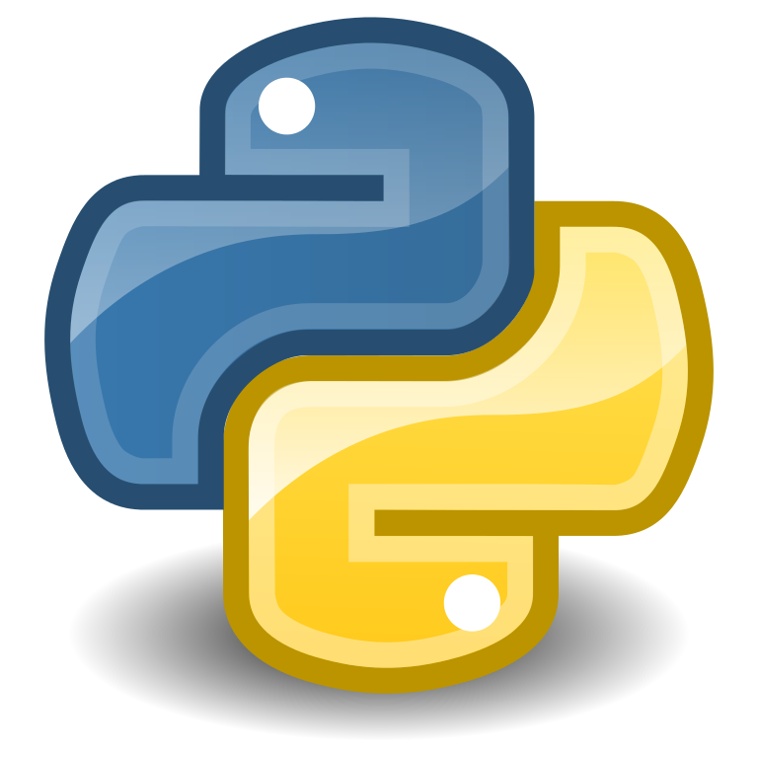
Activity: Identifying Vulnerabilities in an Application
You are developing a Python application that will provide access to a database that contains confidential company information.
Users:
Will have to log in to the application to gain access to the database.
Will be provided with a user account and an initial password that they will have to change when they log in for the first time.
You will start building out the authentication functionality by developing a ValidateStrongPassword function that will check the password the user provides to ensure that it meets the password policy requirements (required length, acceptable characters, and so forth).

Slide 43
Activity: Cracking a Password Hash
You've completed the ValidateStrongPassword function.
You'll need to store the password somewhere for comparison when the user logs in.
To protect the password, you will generate a message digest value and save the digest instead of saving the actual password.
Each time the user logs in, you will generate a message digest value based on the user-entered password and compare it to the digest value you previously saved.
If the two digest values match, then presumably the passwords match.
In this activity, you'll run a little experiment to see how the hash can be cracked.
Later, you will add some code to protect the hash from being easily cracked.

Slide 44
Activity: Fixing a Password Hash Vulnerability
A password hash can be broken through a lookup table, if the attacker:
Knows which encryption algorithm was used
Knows the password rules
Has enough time and processing power to generate a table
In this activity, you will add a salt to provide further protection to the password hash.

Slide 45
Gather Intelligence on Vulnerabilities and Exploits

Slide 46
Vulnerability Intelligence
Information sources regarding vulnerabilities that may affect your software projects:
Are typically free to use
May notify you through subscription (RSS newsfeeds or email lists, for example)
Make sure you monitor information sources for all software your projects use:
Platforms
Modules compiled into applications
Modules external to application, but that run in same process space
Local external APIs your application calls
Web and cloud services your application calls

Slide 47

Exploits
Actual procedures, code, or executables that take advantage of vulnerabilities.
May drive some of the tests you perform on your software projects.
May be illegal or dangerous to experiment with in some situations. (Be careful!)
Should be experimented with in a controlled environment.
May be obtained through various sources on the web.
Examples:
Offensive Security database https://www.exploit-db.com
Common Exploits at https://www.commonexploits.com

Slide 48
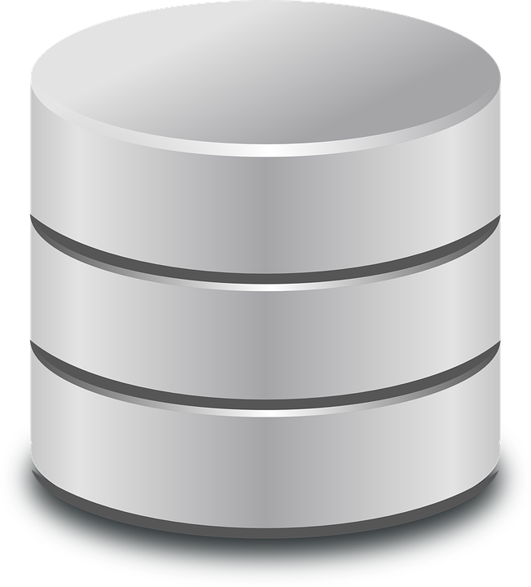

Search Vulnerabilities Database
Vulnerabilities databases
Published by various government and commercial organizations
Do not always contain the latest information, but are generally:
Comprehensive
Include search capabilities
Can be searched automatically by development automation scripts
National Vulnerability Database
https://nvd.nist.gov
The U.S. government's repository of vulnerability management data.
Maintained in the machine-readable format specified by the Security Content Automation Protocol (SCAP).
Includes databases of security checklists, security-related software defects, misconfigurations, product names, and impact metrics.
Offensive Security’s Exploit Database
https://www.exploit-db.com/
A searchable archive of exploits and vulnerable software, supplied in the standard CVE format.

Slide 49
Identify Common Vulnerabilities and Threat Patterns
Command Attack Pattern Enumeration and Classification (CAPEC)
https://capec.mitre.org
Maintained by MITRE Corporation.
A list of common attack patterns.
OWASP Top 10
https://www.owasp.org/index.php/Category:OWASP_Top_Ten_Project
Maintained by Open Web Application Security Project (OWASP).
A list of common threats and strategies for countering them.
OWASP provides many other resources.
CWE/SANS Top 25 Most Dangerous Software Errors
https://cwe.mitre.org/top25
Maintained by the SANS Institute, working with MITRE and other organizations.
A list of the most widespread and critical software errors that can lead to serious vulnerabilities in software.
Overlaps the OWASP Top 10, and the CWE website provides a comparison to the OWASP Top 10.
While OWASP focuses on web and mobile apps, CWE/SANS tends to cover all types of software, include desktop applications.

Slide 50
Subscribe to Vendor Security Bulletins and Advisories
Security bulletins and advisories
Published by vendors of systems, application runtime environments, frameworks, web browsers, and other platforms and tools you use in your software projects.
Provide the most comprehensive and timely source of vulnerability and exploit information for the technologies they cover.
Examples:
Microsoft Security Bulletins https://technet.microsoft.com/en-us/security/bulletins.aspx
Apple Security Updates https://support.apple.com/en-us/HT201222
Android Security Bulletins https://source.android.com/security/bulletin/
Ubuntu Security Notices https://usn.ubuntu.com/
Amazon Web Services Latest Bulletins https://aws.amazon.com/security/security-bulletins/
jQuery Updates Blog https://blog.jquery.com
Chrome Releases https://chromereleases.googleblog.com

Slide 51


Follow Open Source Software Issue Trackers
Open source software project issue trackers
Provide latest information on updates and ongoing issues
Examples:
Node.js https://groups.google.com/forum/#!forum/nodejs-sec
Python Bug Tracker https://bugs.python.org/
Hadoop Issue Tracking https://hadoop.apache.org/issue_tracking.html
MySQL Bugs https://bugs.mysql.com
Docker Issues https://github.com/docker/docker/issues

Slide 52

Follow Security Community Sites
Security blogs, discussion forums, and groups geared toward software development and information security provide insights and reporting on the latest trends in software vulnerabilities and cyber security issues.
Fortinet Blog https://blog.fortinet.com
Naked Security https://nakedsecurity.sophos.com
Securosis Blog https://securosis.com/blog
Uncommon Sense Security http://blog.uncommonsensesecurity.com
Schneier on Security https://www.schneier.com
Krebs on Security https://krebsonsecurity.com
StackOverflow https://stackoverflow.com/questions/tagged/security

Slide 53


Practice Your Hacking Skills
Attacking various websites and applications yourself:
One of the best ways to gain experience with common vulnerabilities
Probably illegal
Will annoy system operators and users
A legal and more polite alternative—use example applications and websites expressly provided for this purpose
OWASP Juice Shop Project Used in this course to provide the "Woodworker's Wheelhouse" online store catalog https://www.owasp.org/index.php/OWASP_Juice_Shop_Project
OWASP Vulnerable Web Applications Directory Project https://www.owasp.org/index.php/OWASP_Vulnerable_Web_Applications_Directory_Project
15 Vulnerable Sites To (Legally) Practice Your Hacking Skills – 2016 UPDATE https://www.checkmarx.com/2016/12/04/15-vulnerable-sites-legally-practice-hackingskills-2016-update/
40+ Intentionally Vulnerable Websites To (Legally) Practice Your Hacking Skills https://www.bonkersabouttech.com/security/40-intentionally-vulnerable-websites-topractice-your-hacking-skills/392
Penetration Testing Practice Lab—Vulnerable Apps / Systems https://www.amanhardikar.com/mindmaps/Practice.html

Slide 54


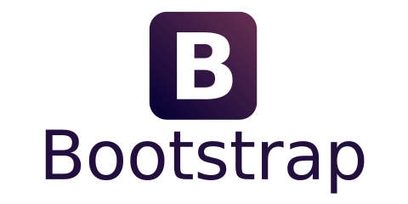

Activity: Identifying Sources for Vulnerability Intelligence
Woodworkers Wheelhouse
Serves as the “setting” for activities in this course.
Imaginary company that sells hardwood lumber, tools, and other supplies for woodworkers and other hobbyists, as well as some home improvement and interior decorating supplies.
You will work on a web-based application for Woodworkers Wheelhouse
Includes a product catalog from which customers can order products online, and various other features.
Prototype app started by another developer.
Developed in:
Node.js version 6.10.3
Express.js
Angular.js
Bootstrap
Other web development frameworks
To begin, you will research Node.js on the web to identify any vulnerabilities in this version.

Slide 55
What major security-focused activities do you currently employ within your development processes?
What other sources of vulnerability intelligence will you use in your own software projects?

